Slide 1
Java SE 17 – Presentation
Migration from Java SE 8 to Java SE 17

Slide 2
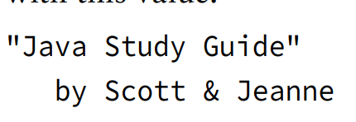
New things
I. Text Block
- We've seen simple ... such as (code illustration snippet 1). However, how can we able to create .... like this:
- We have studied ..., therefore ... (code illustration snippet 2)
- This is a ... string that ... multiple ...
– We can use escape character to create this string, however ...
– Therefore, a feature ... JDK 13 ... called ...

Slide 3
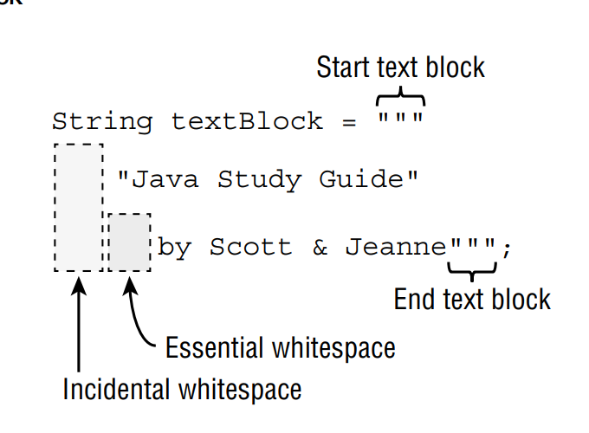
New things
- Text block is started at ... and ended at ...
- ... is the ... on the left ...
- ... is the ... on the right ...
- NOTE: When using text block, we must always ... or else we will get compilation ...
– NOTE 2: In IntelliJ, we can see ... (code illustration snippet 3)

Slide 4
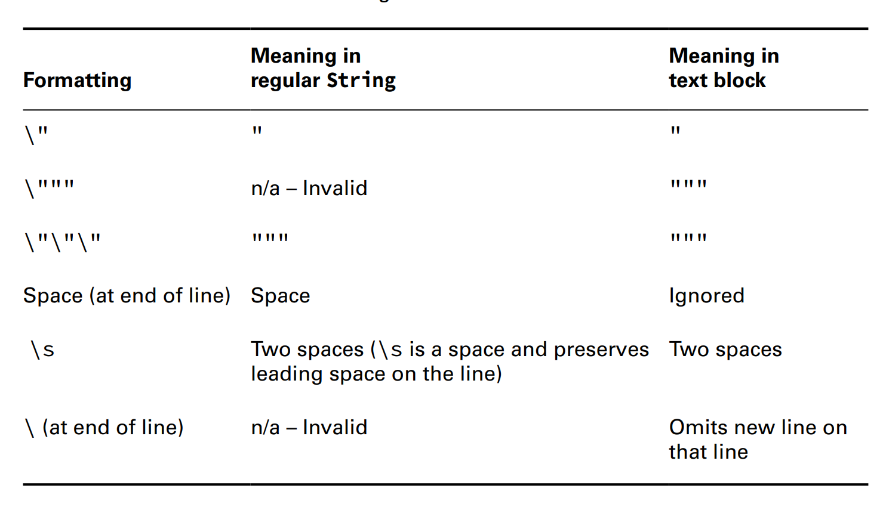


New things
(code illustration snippet 4)
- We can also use ... character in text block
- For "\", we have ... cases with ....

Slide 5
New things
(code illustration snippet 5,6,7,8)

Slide 6
New things
II – Inferring the Type with "var"
- We have been using ... for variable .... But in Java ... (originally Java ...), has introduced a feature called "variable ...". However, to ... feature, certain ... must be ...
(code illustration snippet 9)
- The full name for this feature is called "... variable ..." They called it ... variable because this feature can only be used with ... variable
(code illustration snippet 10)
- We have understood the ... part, then what does ... mean ? When we ... variable using ..., we are instructing ... to ... the type of .... ... will then based on ... and make inferrence about ...
(code illustration snippet 11)
- Differ from traditional ..., local variable type ... allows ... lines ... (code illustration snippet 12)
(code illustration snippet 13)
- The following code didn't compile because both ... and ... use ... but they aren't .... => ... Java type ... => ...
– Although we can see there was a ... branch, however, this wasn't at the same ... as ... => ...
- local variable ... doesn't ... multiple ... (code illustration snippet 13)
(code illustration snippet 14)

Slide 7
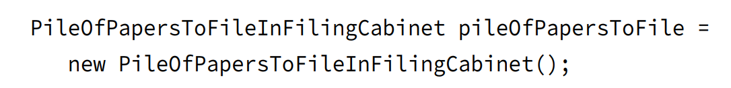
New things
- The illustrated code didnt compile because ... compond .... doesn't allow ...
- The second line got error because ....
- ... can be any ..., Java doesn't know ..., they could just ..., however, it will... => Java ... decided ...
– However, the second line is ... if and only if ... variable ... with a ...
(code illustration snippet 15)
- The illustrated code got error because ... can't be used with ...
- .... keyword isn't a "... word" but rather a "... type" => ... won't be able to used to ... types such as ...
(code illustration snippet 16)
- When do we actually using "var" ? When we have situation like this:
- The name is ... => we use "var" to ... =>

Slide 8
New things
III – instanceof operator (not a new thing but we never learned this in OCA SE 8)
- Another type of operator we have to learn is ...
– Its job is to ... (code illustration snippet 17)
- We can see that there are ... but ... => This is object ... => if we use ..., the value will be ...
– There are some cases where ... polymorphism ... (e.g: create a ... that recieve ...)
(code illustration snippet 18)
- We can also see that in the method, we ... "time" from ... to ....
- This is .... when using .... with objects that ...
- Generally, we "should" ... before ...
- NOTE: For the exam, we will only be asked about .... with ... or ...., although ... can be used with other ... such as ...
Invalid "instanceof"
- When using instanceof with ...., we will get ...
null and the instanceof operator
- When we use ... with ... => we will always get ...
– Even if we ... in a ... => We will still get ...
– But if we try ... => We get a ...

Slide 9
New things
IV – Shortening code with Pattern Matching
- In Java ..., a new ... has been developed called "Pattern Maching". This ... uses ... statement and ....
- Pattern matching is a ... used in ... that allows ... runs under certain ...
(pattern matching # ...)
- ... is borned to reduce ... code (... code is a type of code that ... multiple...). Later version ... trying to .... code
(code illustration snippet 19)
- As you can see in the method, we always ... => ...
- We have to do ... because the method ... is only ...
– This type of code appears ... that Java ... has to ...
(code illustration snippet 20)
- If the ... is ... => we cast ... and ... => We can use ...
– The ... "data" is called ... This new type of code even removes ... because cast can only be done when ...
- Reassigning ... is often considered ... because we can't ....
(code illustration snippet 21)
- We can ... this ... by ... (code illustration snippet 22)

Slide 10
New things
Pattern variables and Expressions
- Pattern matching also allows us to ... to ... data
(code illustration snippet 23)
- A condition to use ... is .... It can't be a ..., a ..., and a ...
– Although normal ...
(code illustration snippet 24)
Flow scoping
- ... has something called flow scoping. Flow scoping is used to ... variable.
- Unlike traditional ..., the ... variable ... based on ...
(code illustration snippet 25)
- In illustrated example, we use ... instead of ... which ... => The ... will run ... => ...
(code illustration snippet 26, 27)
- According to Java ... a variable ... in ... cases
+) The condition ...
+) The condition ... and ... completed ... (all of the statements such as ... counted as ...)
=> These are ... variable ...

Slide 11
New things
(code illustration snippet 28,29)
- The scope of ... is defined ... (note 1)
V – New swtich statement feature and Switch Expression
- In Java 14 of ..., allowed to ....
(code illustration snippet 30)
(code illustration snippet 31)
- We can see that this method is .... => in Java ..., a new type of ... called ....
- It has ... syntax than ...
– We use it as a ... and assign .... (of course the type ...)
(code illustration snippet 32)
- Of course we can use ... normal ..., and we can ... combine ... (code illustration snippet 33)
- Rules when using ...
+)
+)
+)
- However, if switch isn't ... then ... needed
Notes:
NOTE 1: https://docs.oracle.com/javase/specs/jls/se17/html/jls-6.html#jls-6.3.2:~:text=a%20when%20false.-,6.3.2.%C2%A0Scope%20for%20Pattern%20Variables%20in%20Statements,-Only%20a%20few

Slide 12
New things
- For ... expression, ... is needed because it doesn't differ from ... => a ... is needed at the ....
– In new ..., if we don't use ... => we must have ...
- Otherwise, we don't need ...
(code illustration snippet 32, again
VI – New String class methods
strip()
stripLeading() and stripTrailing()
- NOTE: strip() and trim() .... but strip()...
working with indentation
- We have 2 new methods for ...
indent(int numberSpaces)
- If we add a ... number => ...
– If we add a ... number => If ... than the total ... =>
- But if the number ... than the total => ...
- If we add 0 => ...
Notes:
NOTE 1: https://docs.oracle.com/javase/specs/jls/se17/html/jls-6.html#jls-6.3.2:~:text=a%20when%20false.-,6.3.2.%C2%A0Scope%20for%20Pattern%20Variables%20in%20Statements,-Only%20a%20few

Slide 13
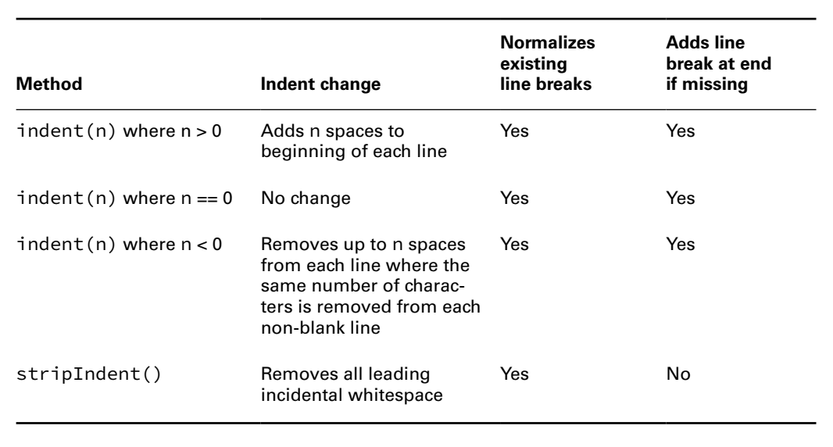


New things
- Indent also add a ... if .... This is because if we add a ... before the line ... => ... won't ... => We must add a ... to move ... line
(code illustration snippet 34)
- However, when we use ... with .... String ... there will be ... cases:
+)... (code illustration snippet 35)
+)...(code illustration snippet 36)
(the book explains stripIndent() in a pretty stupid way, so I will explain it in my way) - stripIndent() is usually used with ... String, but use ... to represent ... => The ... line and ... space will ... => This method will ...
(code illustration snippet 37)
Notes:
NOTE 1: https://docs.oracle.com/javase/specs/jls/se17/html/jls-6.html#jls-6.3.2:~:text=a%20when%20false.-,6.3.2.%C2%A0Scope%20for%20Pattern%20Variables%20in%20Statements,-Only%20a%20few

Slide 14
New things
- In ... String, if we add a "\" ... => ....
- To transform ...., we use translateEscape()
(code illustration snippet 38)
formatted()
(code illustration snippet 39)
NOTE: %f ....
– If we try to pass ... => exception ...
(code illustration snippet 40)
- format() also support something called ...
- We have seen some example about "%f". For standard, %f will ...., but we can ... this ... by applying ... (Be careful, Java will ... the number if we using this...)
(code illustration snippet 41)
- We can also ... length of ... by using ...
(code illustration snippet 42)
Notes:
NOTE 1: https://docs.oracle.com/javase/specs/jls/se17/html/jls-6.html#jls-6.3.2:~:text=a%20when%20false.-,6.3.2.%C2%A0Scope%20for%20Pattern%20Variables%20in%20Statements,-Only%20a%20few

Slide 15
New things
- If we try to specify ... length ... than ... => Whole ... and the decimal ... depend...
(code illustration snippet 43)
- Also, if we try to specify .... length ... than => Space ...
(we can add 0 ...)
(code illustration snippet 44)
Notes:
NOTE 1: https://docs.oracle.com/javase/specs/jls/se17/html/jls-6.html#jls-6.3.2:~:text=a%20when%20false.-,6.3.2.%C2%A0Scope%20for%20Pattern%20Variables%20in%20Statements,-Only%20a%20few

